Slide 1
FREEZING OF GAIT
Reference Papers:
Click To Access Papers
KARTIK KHARBANDA
NIT DELHI

Slide 2
Advantages of ML
Integration of ML in Gait Analysis helps in processing the large amount of data available.
Help provide models enabling predicting tasks.
ML is excessively used in the healthcare industry.
Helps deal with a large number of inter dependant parameters.
ML techniques show accuracies greater than 90% in Gait analysis.

Slide 3
FOG DETECTION
Models Used:
Decision Tree Classifier
Random Forest
SVC
KNN
Ada Boost Classifier

Slide 4
FEATURES SELECTED
1. Time Features
METRIC | SENSOR | AXIS
Mean | Ankle | X, Y, Z
 | Leg | X, Y, Z
Standard Deviation | Ankle | X, Y, Z
 | Leg | X, Y, Z
Variance | Ankle | X, Y, Z
 | Leg | X, Y, Z
Root Mean Square | Ankle | X, Y, Z
 | Leg | X, Y, Z
Minimum | Ankle | X, Y, Z
 | Leg | X, Y, Z

Slide 5
2. Sensor Features
METRIC | SENSOR | AXIS
Entropy | Ankle | X, Y, Z
 | Leg | X, Y, Z
 | Torso | X, Y, Z
Energy | Ankle | X, Y, Z
 | Leg | X, Y, Z
 | Torso | X, Y, Z
Peak Frequency | Ankle | X, Y, Z
 | Leg | X, Y, Z
 | Torso | X, Y, Z
Freezing Index | Ankle | X, Y, Z
 | Leg | X, Y, Z
 | Torso | X, Y, Z
Power | Ankle | X, Y, Z
 | Leg | X, Y, Z
 | Torso | X, Y, Z

Slide 6
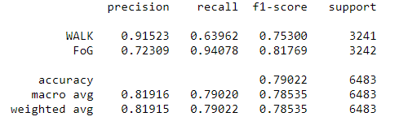
DECISION TREES
Model Size: 2.386kB

Slide 7
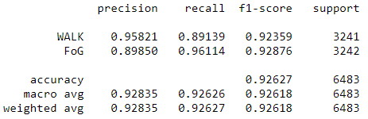
RANDOM FORESTS
Model Size : 22008.224kB
Specificity :0.90

Slide 8
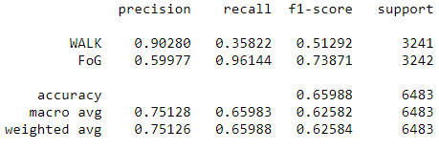
SVM
Model Size: 1578.420kB

Slide 9
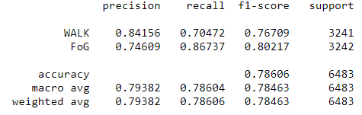
KNN
Model Size: 3951.985kB

Slide 10
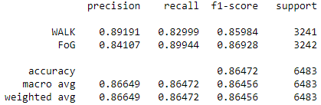
ADA BOOST CLASSIFIER
Model Size: 34 kB

Slide 11
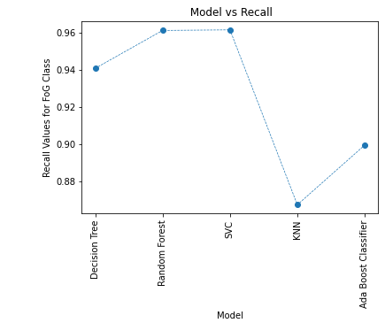

Slide 12
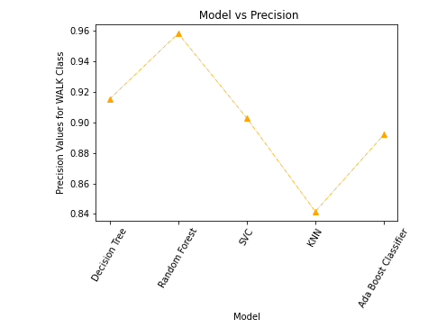

Slide 13
INDIVIDUAL PATIENT ANALYSIS FOR FOG PREDICTION
Experiment Conditions:
Model Used: Decision Tree Classifier
To avoid over-representation of one particular class, size of Walk class was chosen to be 1.5 times the walk class.
size of walk = 1.5 * size of fog
The hyper parameters of the model were not tuned since the objective of the experiment is to identify the primary features.
Each window length is 1s (64 samples)

Slide 14
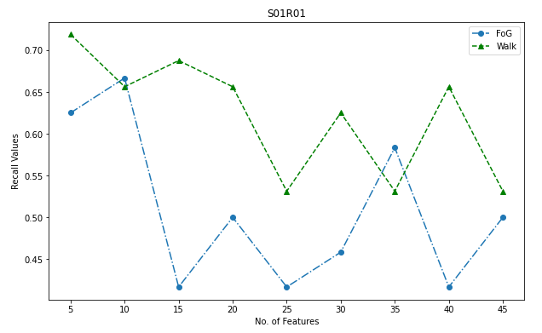
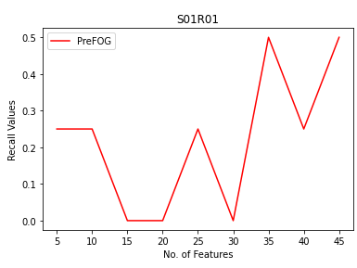
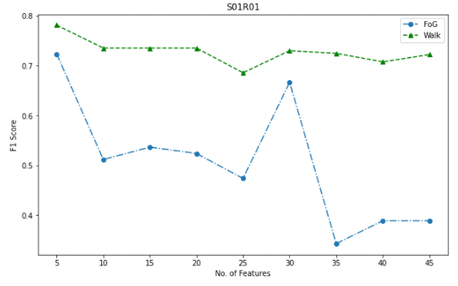
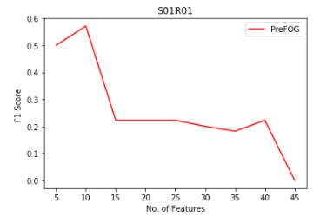
S01R01

Slide 15
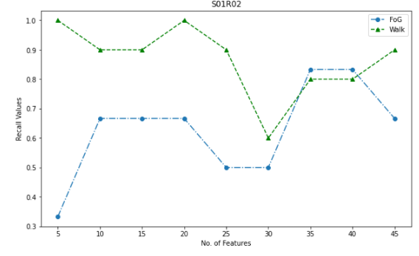
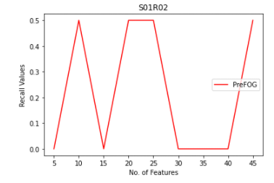
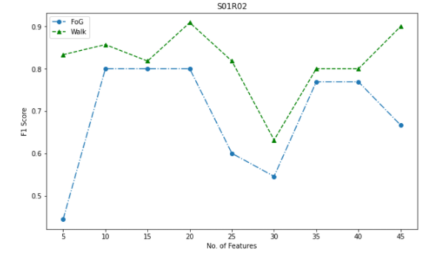
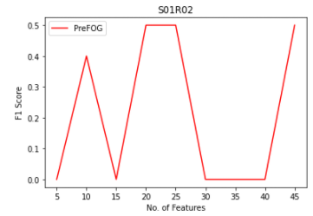
S01R02

Slide 16
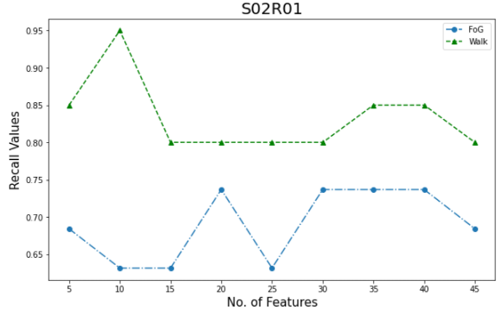
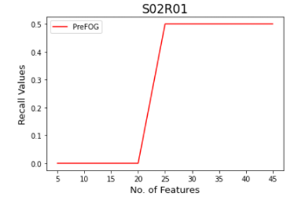
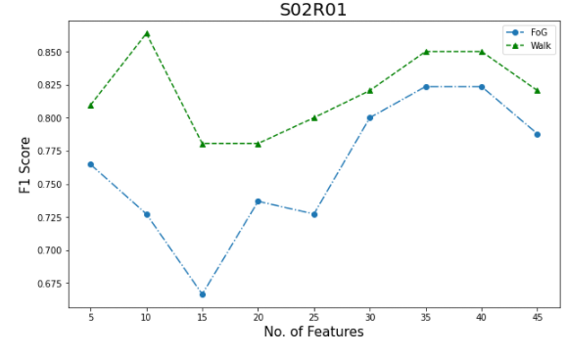
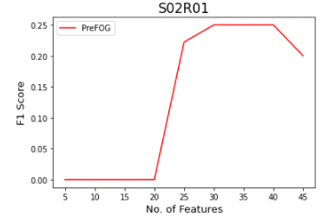
S02R01

Slide 17
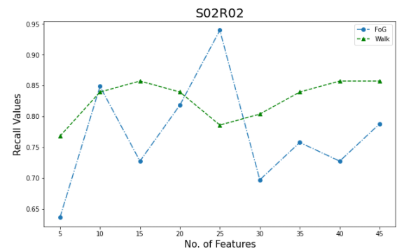
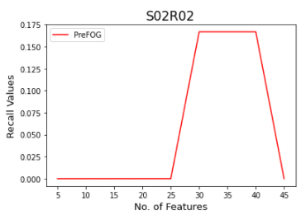
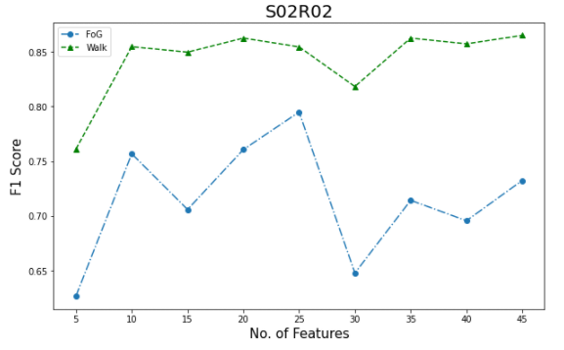
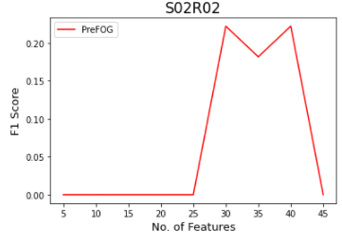
S02R02

Slide 18
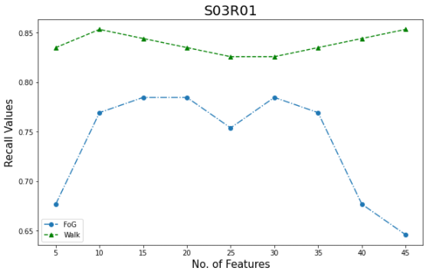
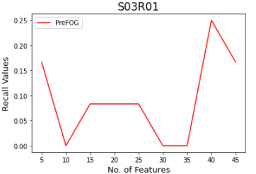
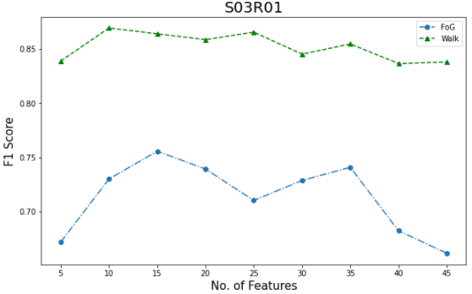
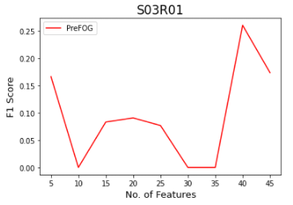
S03R01

Slide 19
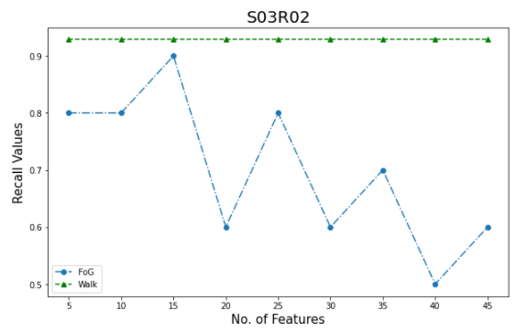
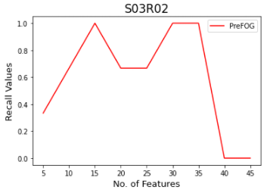
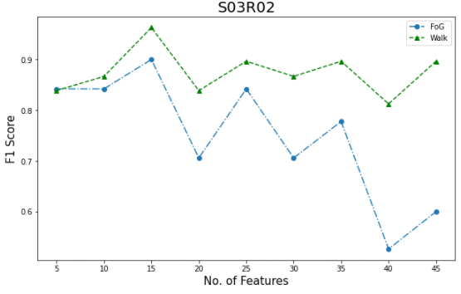
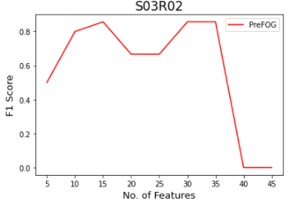
S03R02

Slide 20
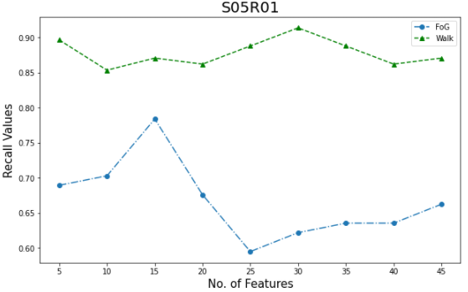
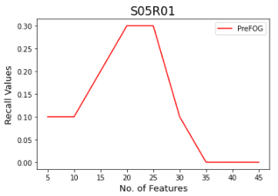
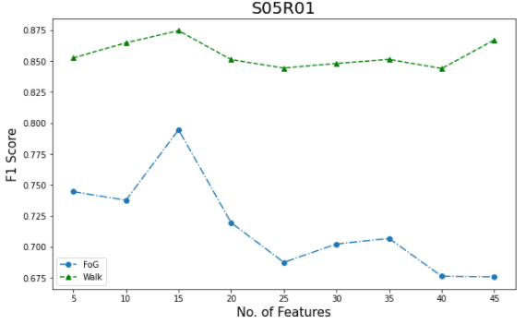
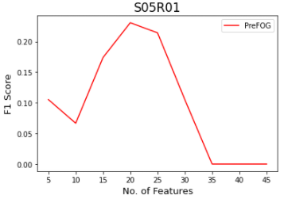
S05R01

Slide 21
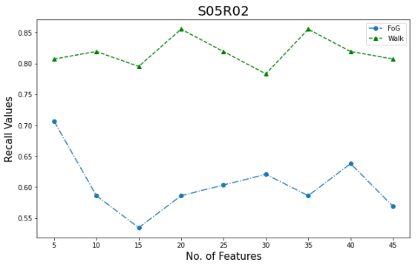
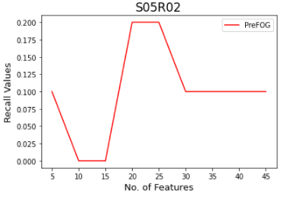
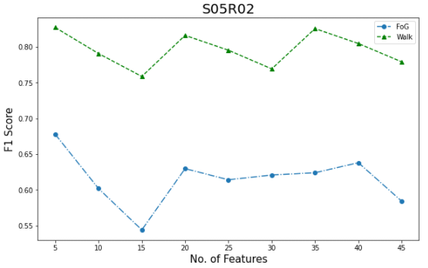
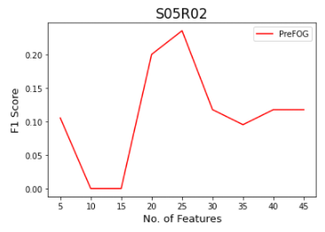
S05R02

Slide 22
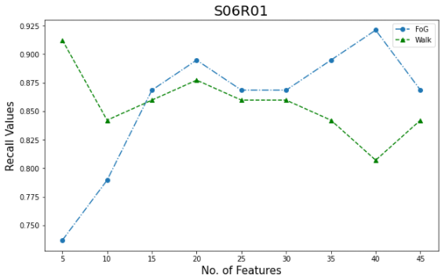
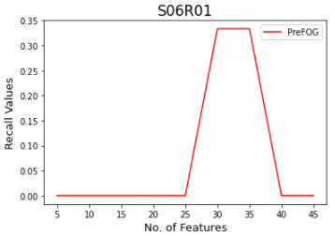
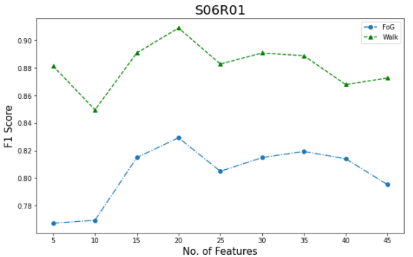
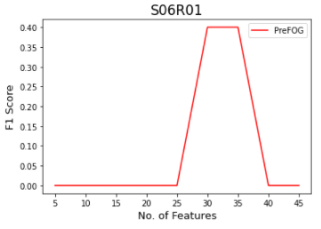
S06R01

Slide 23
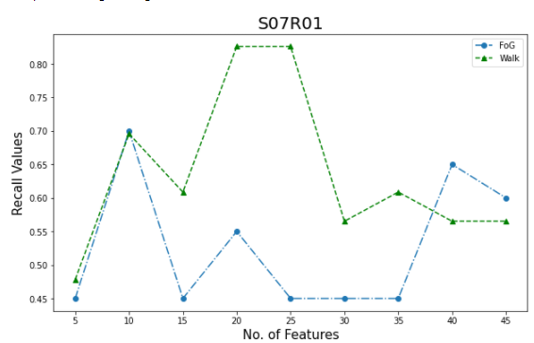
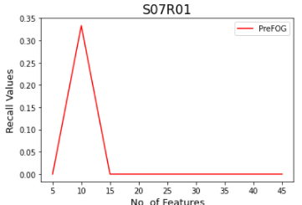
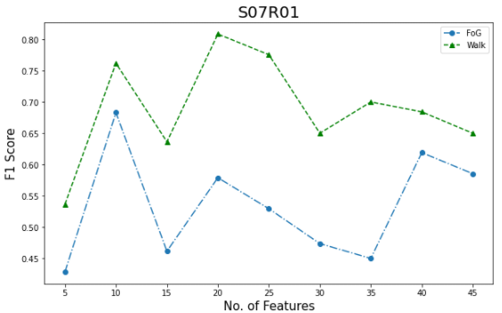
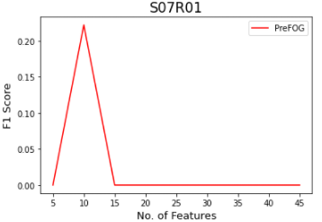
S07R01

Slide 24
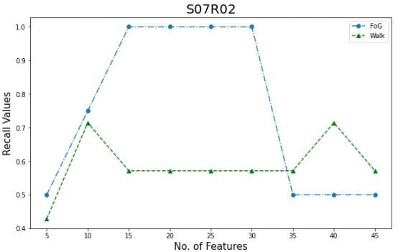
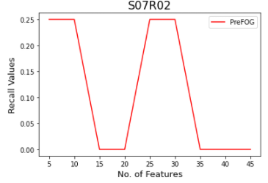
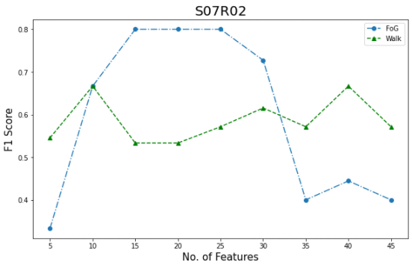

S07R02

Slide 25




S08R01

Slide 26




S09R01

Slide 27

Mean F1 Score across each patient varying with the no. of features

Slide 28
OBSERVATIONS
PreFoG prediction is highly patient dependant having a maximum F1 score of 0.83 for one particular patient. (Improvement from the paper by 33%)
Recall values for PreFoG prediction vary around the 50% range.
Value of F1 Score for detection reaches a maximum value when the no. of features are between 15-25.
Best detection occurs when no. features are set to 20.
For one particular patient, recall values for FoG detection reached 1.

Slide 29
ALTERNATE APPROACH FOR DETECTION
The models presented in the following slides are:
Decision Tree Classifier
Random Forest Classifier
SVC
The features of the training data are not selected by recursive feature elimination algorithm.

Slide 30



DECISION TREES

Slide 31
No. of Features | Accuracy | Model Size (in kB) | Specificity
5 | 0.85114 (+/- 0.03717) | 18.522 | 0.98087
10 | 0.99815 (+/- 0.00360) | 2.103 | 1
15 | 0.98873 (+/- 0.03070) | 2.682 | 1.0
20 | 0.99364 (+/- 0.01687) | 4.122 | 1.0
25 | 0.90380 (+/- 0.10955) | 17.226 | 0.9318322023442319
30 | 0.88640 (+/- 0.04854) | 13.770 | 0.9799506477483035
35 | 0.92634 (+/- 0.09406) | 13.770 | 0.9879703886489821

Slide 32


RANDOM FORESTS

Slide 33
No. of Features | Accuracy | Model Size (in kB) | Specificity
5 | 0.72925 (+/- 0.20640) | 13648.160 | 0.7711289327575571
10 | 1.00000 (+/- 0.00000) | 2332.460 | 1.0
15 | 0.99775 (+/- 0.00949) | 3520.274 | 1.0
20 | 0.99758 (+/- 0.01008) | 3357.356 | 1.0
25 | 0.99767 (+/- 0.00946) | 3426.194 | 0.8621
30 | 0.99710 (+/- 0.01054) | 4119.050 | 1.0
35 | 0.99605 (+/- 0.01238) | 4846.238 | 1.0

Slide 34

SVC

Slide 35
No. of Features | Accuracy | Model Size (in kB) | Specificity
5 | 0.56905 (+/- 0.12382) | 784.160 | 0.735
10 | 0.57210 (+/- 0.12386) | 1323.260 | 0.817
15 | 0.57372 (+/- 0.13105) | 1845.400 | 0.8439
20 | 0.56600 (+/- 0.12118) | 2329.400 | 0.8528
25 | 0.56604 (+/- 0.09053) | 3130.960 | 0.8621
30 | 0.55383 (+/- 0.11020) | 3732.200 | 0.8670
35 | 0.55045 (+/- 0.10610) | 4258.460

